Slide 1

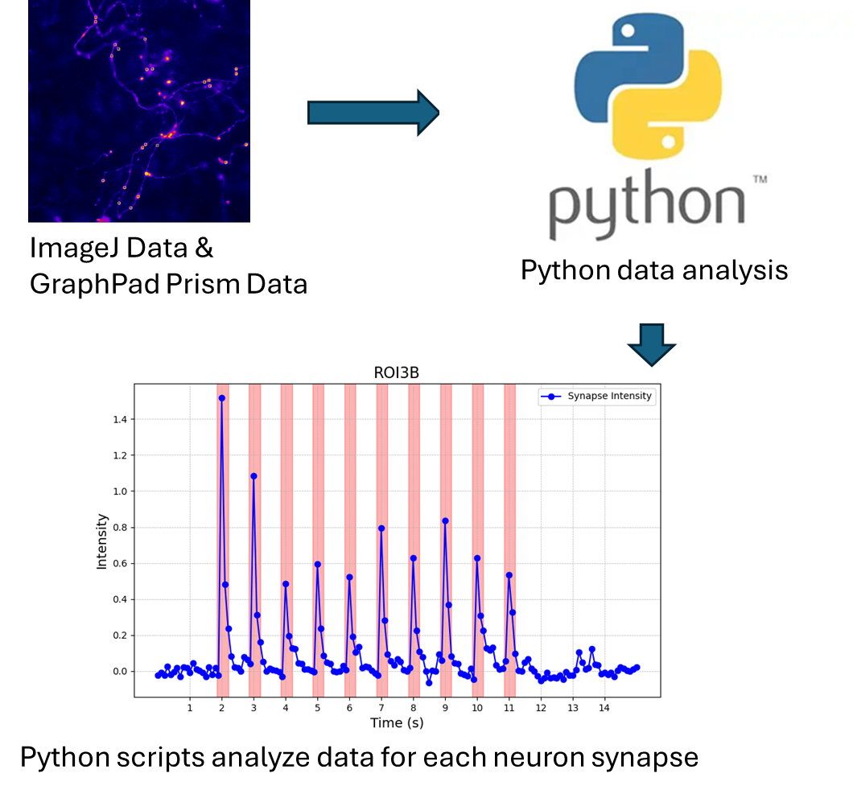
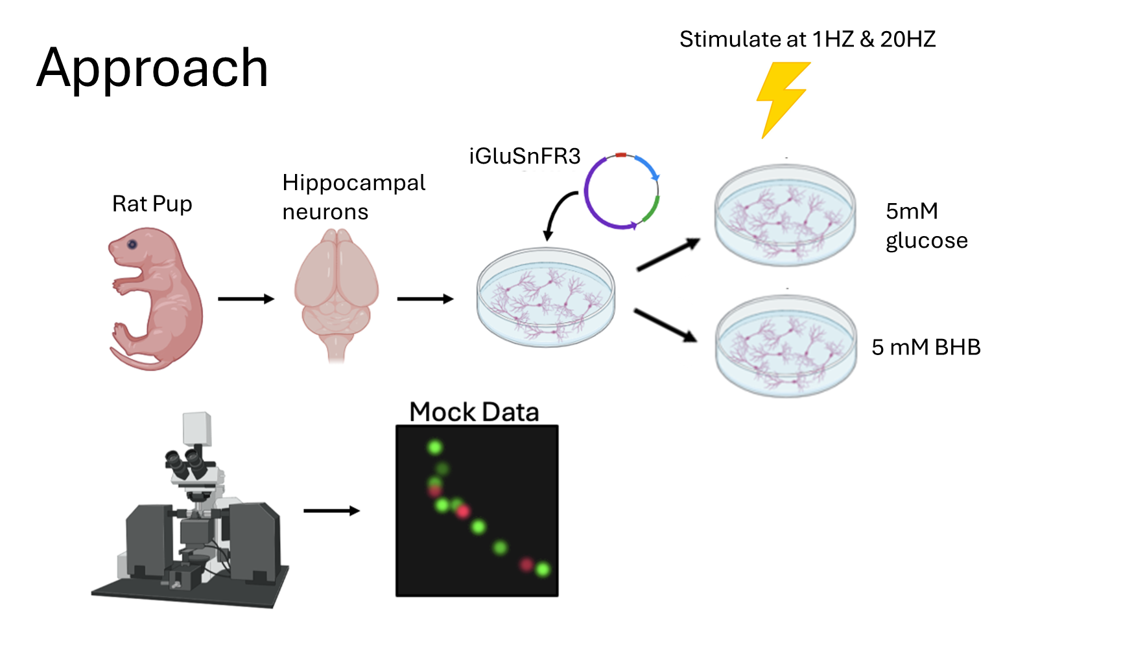
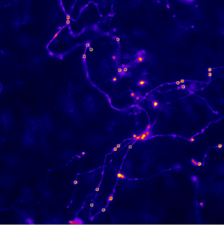
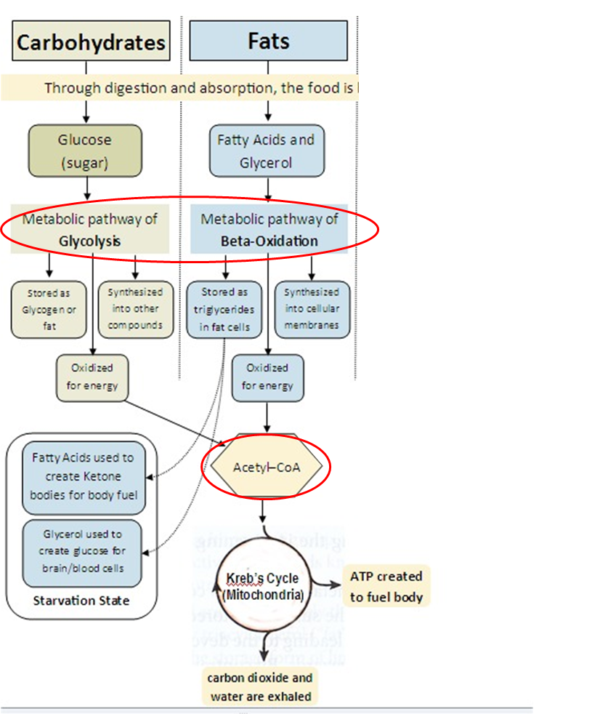
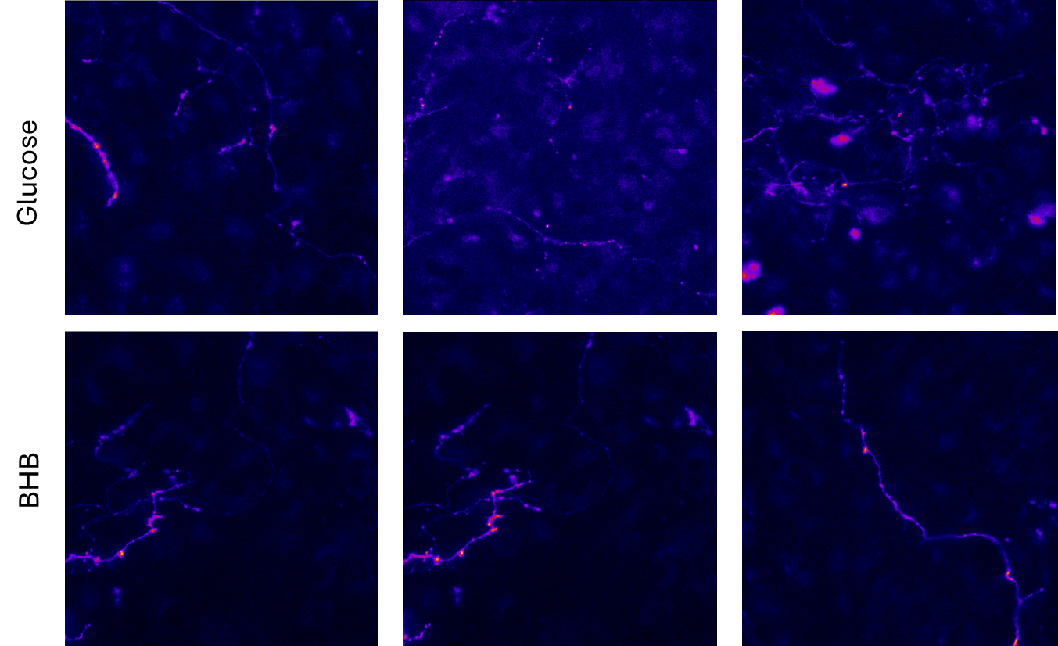
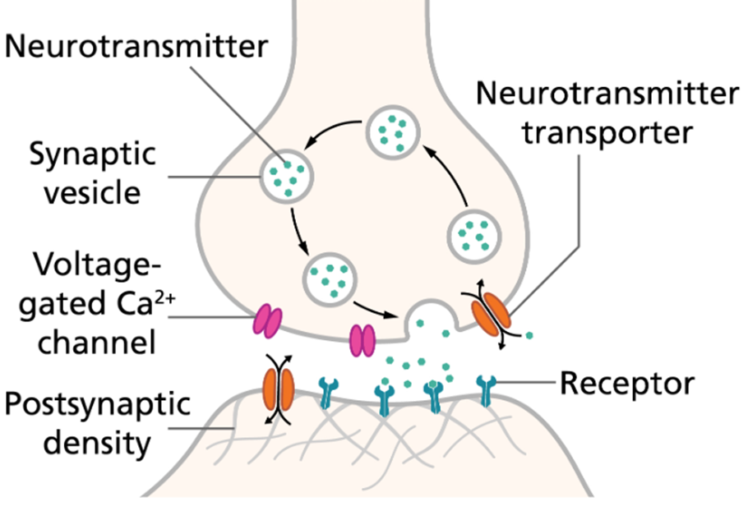
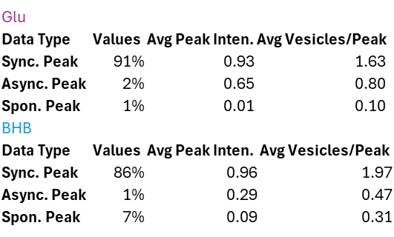

Ketogenic Diet Impact on Glutamate Release at the Synapse
Davin Harvey, Kelly Wichmann, Alexandra Ware, Ghazaleh Ashrafi
WashU Medicine Department of Cell Biology and Physiology
Introduction
Research Methods
Ketogenic diets have been used to reduce the overall excitability of brain circuits, and therefore as an effective treatment for drug-resistant childhood epilepsies. However, it remains unclear how ketones alter neuronal function at the cellular and molecular level. Ketosis is a metabolic state characterized by elevated levels of ketone bodies in the bloodstream that are produced from fat stores by the liver, for example, during fasting or after prolonged physical activity. A significant portion of neuronal energy budget is allocated to nerve terminals, which rely on ATP to power processes like establishing ion gradients and facilitating the release, retrieval, and reacidification of synaptic vesicles (SVs). SV retrieval is highly sensitive to energetic perturbations and is significantly slower in neurons supplied with ketones as compared to lactate/pyruvate, suggesting a metabolic defect in terminals relying on ketone oxidation. However, the effects of ketone metabolism on different aspects of synaptic transmission remain poorly explored. Understanding how the metabolic shift to ketones happens in neurons, and what the functional consequences are is critical to understanding the impact of ketones on brain function. We hypothesize that neurons in ketone solution will fire less frequently and less intensely than those in glucose media.
ORANGE (Open Resource for the Application of Neuronal Genome Editing) method tags key neuron synapse with fluorescent protein iGluSnFR3
Transfect prenatal rat pup cortical neurons with edited plasmids
CRISPR/CAS9 edits genome to add fluorescent tags to neurons
Neurons are separated into two separate cultures with glucose and BHB
Neurons are stimulated at 1HZ and 20HZ for each media condition
Synchronous, asynchronous, and spontaneous firing is measured for each condition
Figure 3. Diagram depicting the transfection process in detail. Rat pups are extracted from pregnant mothers at Embryonic Day 17 (E17). The cerebral cortex is extracted for the pups to harvest cortical neurons which are dissociated gently with papain into a single-cell suspension and plated. The neurons are then split into two medias — one with 5mM glucose and another with 5mM concentration of BHB. The neurons are imaged while they are being stimulated with a 1HZ AP and a 20 HZ AP train. Synaptic activity where glutamate release is occurring is observed.
Figure 4. Representation of the data analysis workflow that enabled tracking of glutamate release and classified release as synchronous, asynchronous, and spontaneous. Synapse release from each imaged neuron was selected and Python scripts automated classification of peak type and normalized intensity for 1HZ data. For 20HZ data, tau values were measured using different scripts and average peak intensities were taken.
Figure 1. Depiction of the different energy pathways involving glycolysis and ketosis. Typical glycolytic pathways are shown (to the left) as carbohydrates are broken down into glucose to undergo glycolysis then eventually go to the citric acid cycle. On the right of the diagram, ketosis is shown as fats are oxidized for energy instead of glucose. In ketosis, Acetyl-CoA is still synthesized to go into the citric acid cycle. In both energy pathways, this synthesis is a commonality and energy production goes on similarly after this point.
Preliminary Results
Conclusions & Future Direction
Figure 5. Images of neurons in glucose and BHB medias being stimulated with an action potential train of 20HZ. The punctuated fluorescent dots within the axon represent synapse where glutamate is being released. iGluSnFR3 fluoresces when glutamate leaves the synapse, creating these spots of fluorescence throughout the images. Fluorescent intensity in the glucose solution tended to be about 26% more intense than neurons stimulated in the BHB solution.
Conclusions: Preliminary findings from the 20HZ data suggest that neurons in the BHB media fired less intensely than those in the glucose media. In addition, the rate of decay for BHB was smaller than that of glucose. While the data acquired was not significant due to high error bars, for every data set that was analyzed the neurons in BHB fired less intensely than those in glucose. However, when analyzing the neurons that were stimulated at 1HZ, there appeared to be no significant difference in the neuronal activity between the hippocampal cells in BHB and in glucose.
Future Direction:
Stimulate at a higher frequency than 20HZ
Give cells various concentrations of glucose and BHB
1
Figure 2. Diagram represents the mechanisms of a firing action potential (AP) and refilling of synaptic vesicles (SV). When and AP is sent through a neuron, depolarization occurs and Ca2+ rushes into the presynaptic neuron. Neurotransmitters like glutamate are released into the synaptic cleft and bind to receptors to fire a postsynaptic AP. SV refilling occurs and is one of the most energy demanding steps of the process.
Figure 6. Data was collected from each media condition at different frequencies (1HZ stimulation left and 20HZ stimulation right). From each neuron, synaptic activity is analyzed and averaged among all the neurons to produce a cumulative data set. High error bars are attributed to significant intensity differences across neurons within different cultures. Synchronous, asynchronous, and spontaneous data are classified with average peak intensity and vesicles released for 1HZ data (left). No significance difference is shown in percentage of successful stimulations, average peak intensity, or vesicles released. For 20HZ stimulation, average peak intensity and rate of decay are collected for each media. The average intensity of the neurons in glucose are greater than those in BHB and have a greater rate of decay
Acknowledgments and References
I would personally like to thank my mentor Kelly Wichmann, Dr. Ghazaleh Ashrafi, and the rest of the Ashrafi lab for helping me explore the field of research.
References:
Figure 2, Thomas Splettstoesser et al 2012

